Slide 1
Lecture 5 Measures of location and spread

Slide 2
Review
Describing the shape of distribution
How many peaks? Unimodal, bimodal, multimodal
Is the distribution symmetric or is it skewed?
Are there outliers in the data?
Two numbers to describe the center of distribution:
Mean the average value of a distribution – it is NOT resistant to outliers
Median the middle value of a distribution – it is resistant to outliers
The mode is a measure of location
It describes the position of commonly occurring values (i.e the position of peaks in the distribution)

Slide 3
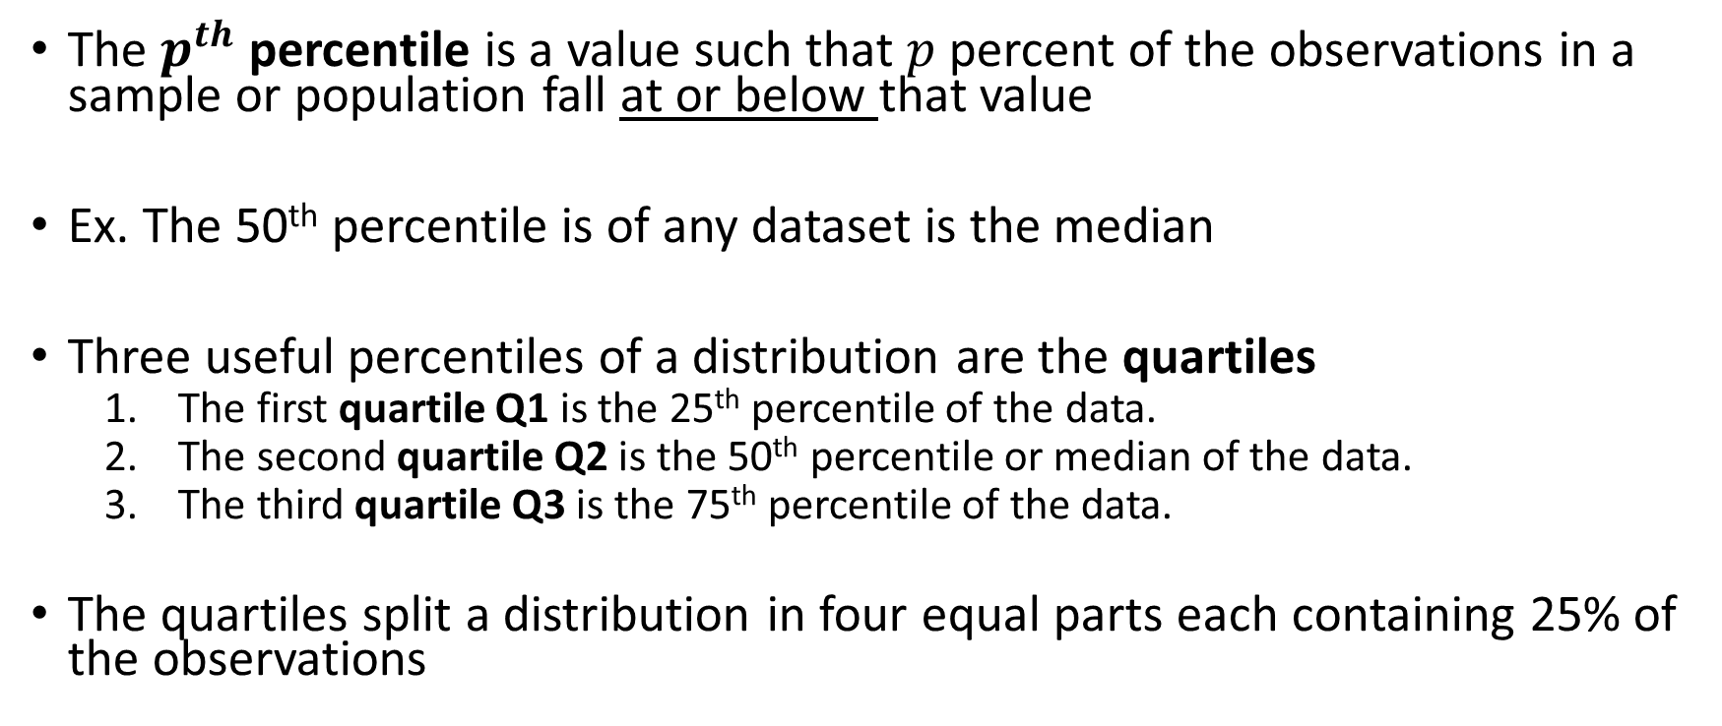
Measures of Location: Quartiles and Percentiles
The $p^{th}$ percentile is a value such that $p$ percent of the observations in a sample or population fall at or below that value
Ex. The 50th percentile is of any dataset is the median
Three useful percentiles of a distribution are the quartiles
The first quartile Q1 is the 25th percentile of the data.
The second quartile Q2 is the 50th percentile or median of the data.
The third quartile Q3 is the 75th percentile of the data.
The quartiles split a distribution in four equal parts each containing 25% of the observations

Slide 4
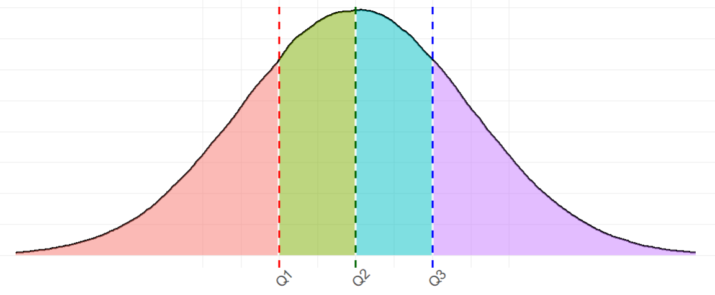
Measures of Position: Quartiles and Percentiles
Median
25%
50%
75%
25%
25%
25%
25%

Slide 5
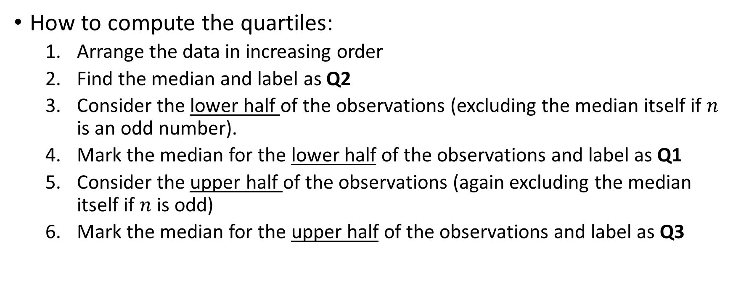
Measures of Position: Quartiles and Percentiles
How to compute the quartiles:
Arrange the data in increasing order
Find the median and label as Q2
Consider the lower half of the observations (excluding the median itself if $n$ is an odd number).
Mark the median for the lower half of the observations and label as Q1
Consider the upper half of the observations (again excluding the median itself if $n$ is odd)
Mark the median for the upper half of the observations and label as Q3

Slide 6
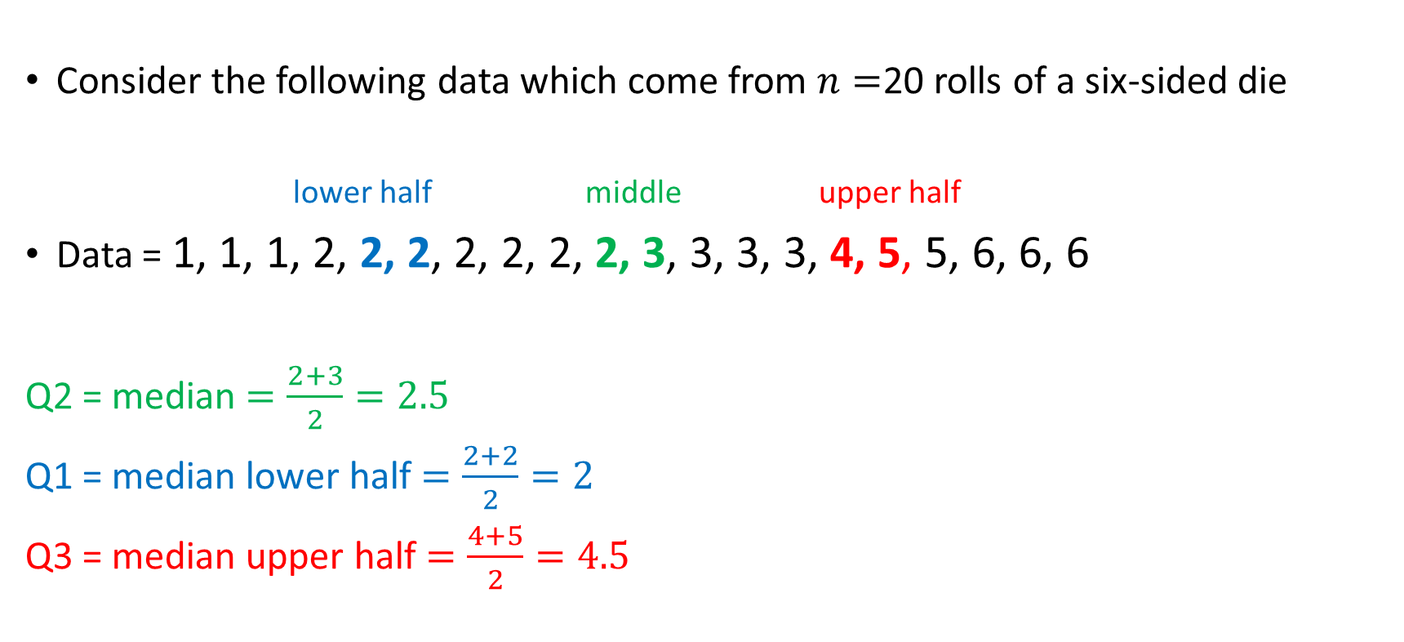
Ex. Quartiles
Consider the following data which come from $n=$20 rolls of a six-sided die
lower half middle upper half
Data = 1, 1, 1, 2, 2, 2, 2, 2, 2, 2, 3, 3, 3, 3, 4, 5, 5, 6, 6, 6
Q2 = median $=\frac{2+3}{2}=2.5$
Q1 = median lower half $=\frac{2+2}{2}=2$
Q3 = median upper half $=\frac{4+5}{2}=4.5$

Slide 7
Practice
Consider the following 15 exam scores of students in a statistics course
61,61,65,65,66,68,69,73,74,75,76,78,79,90,94
Compute the 3 quartiles Q1, Q2, and Q3

Slide 8
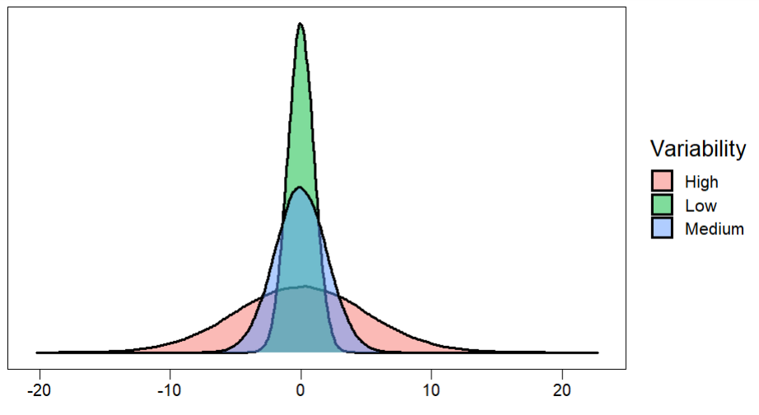
Variability of A Distribution: Measures of Spread

Slide 9
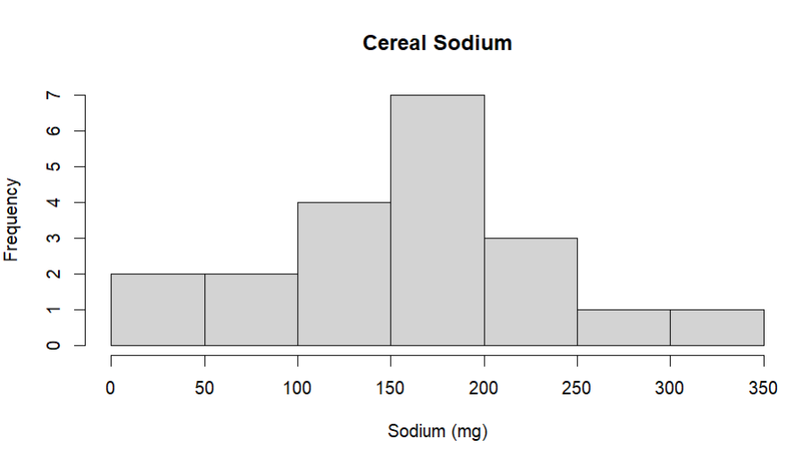
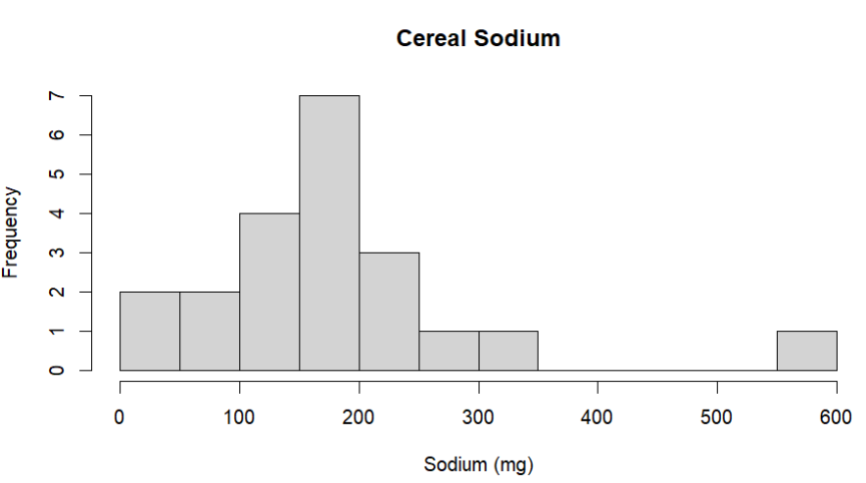
Measures of Spread: Range
The range is a measure of the distance between the smallest and largest values in the data
The range can be computed with only two data points the minimum value and maximum value
If the range of a set of data is large, then usually this indicates greater dispersion of values
The range is severely affected by the presence of outliers
We typically do not use the range to measure variability

Slide 10
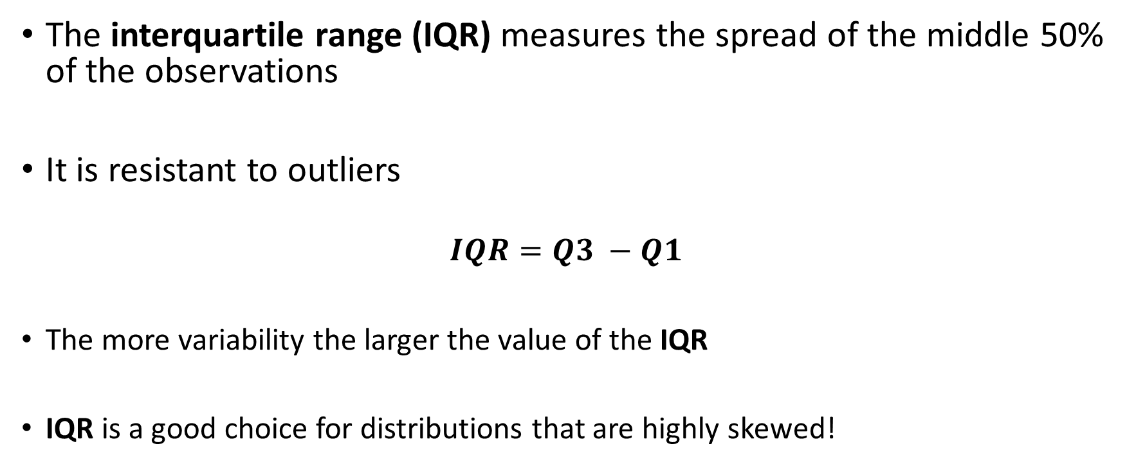
Measures of Spread: Interquartile Range
The interquartile range (IQR) measures the spread of the middle 50% of the observations
It is resistant to outliers
$$IQR=Q3 −Q1$$
The more variability the larger the value of the IQR
IQR is a good choice for distributions that are highly skewed!

Slide 11
Practice: Finding quartiles and IQR
Exam Scores 61,61,65,65,66,68,69,73,74,75,76,78,79,90,94
Compute the IQR

Slide 12
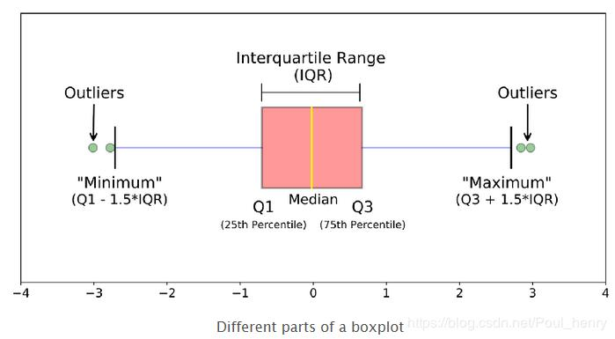
The Boxplot (Box and Whisker Plot): A five number summary
Pros:
good for describing shape and location
Can be used to identify outliers
Length of whiskers indicates skew
Good for comparing two distributions or across categories
Cons:
does not show certain features like mounds, or gaps as well as a histogram

Slide 13
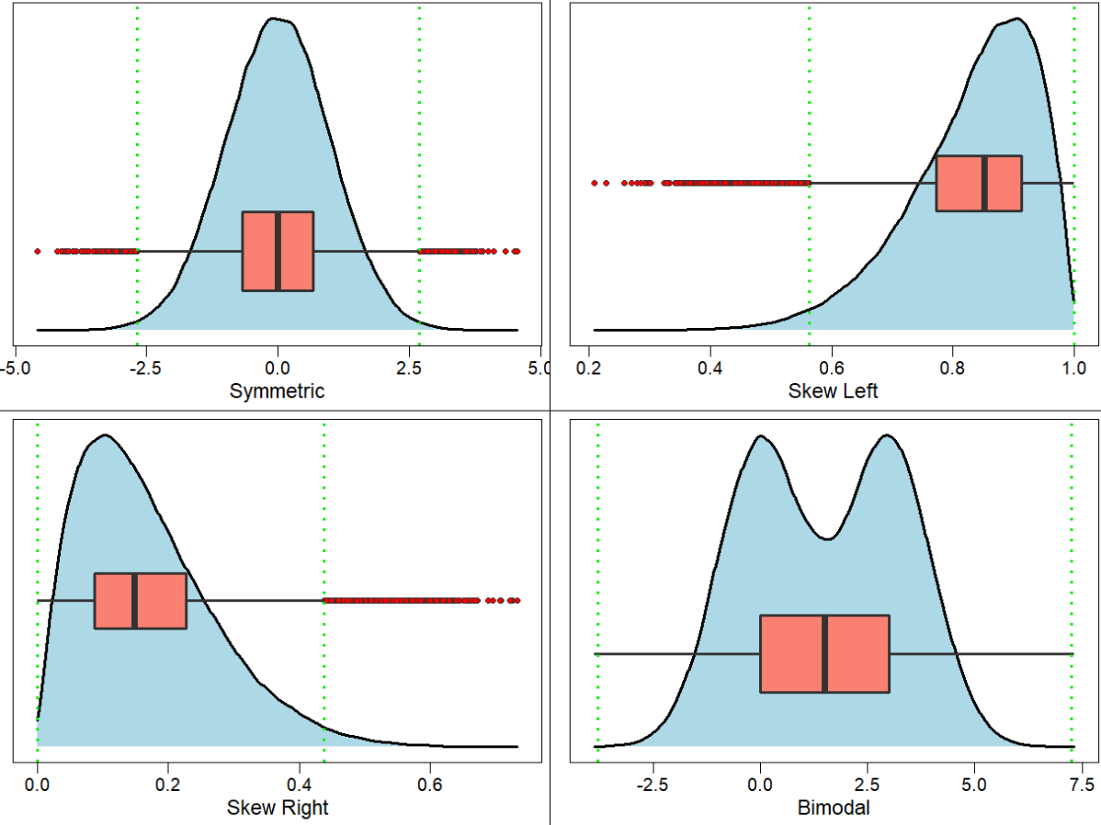

Slide 14

Ex. Construct a Boxplot
Consider the following data which come from 20 rolls of a six-sided die
lower half middle upper half
Data = 1, 1, 1, 2, 2, 2, 2, 2, 2, 2, 3, 3, 3, 3, 4, 5, 5, 6, 6, 6
Q2 = median $=\frac{2+3}{2}=2.5$
Q1 = median lower half $=\frac{2+2}{2}=2$
Q3 = median upper half $=\frac{4+5}{2}=4.5$

Slide 15
Practice
Construct the boxplot for student exam scores
Exam Scores 61,61,65,65,66,68,69,73,74,75,76,78,79,90,94

Slide 16
Ex2. Construct a Boxplot
Consider the following 12 observations of a quantitative variable X
X = { -5.7, -2.6, -1.5, -1.3, -0.4, 0.2, 1.5, 2.2, 2.3, 2.6, 2.9, 10.4 }
Compute the 5 number summary and draw a boxplot
Compare the IQR with the range

Slide 17
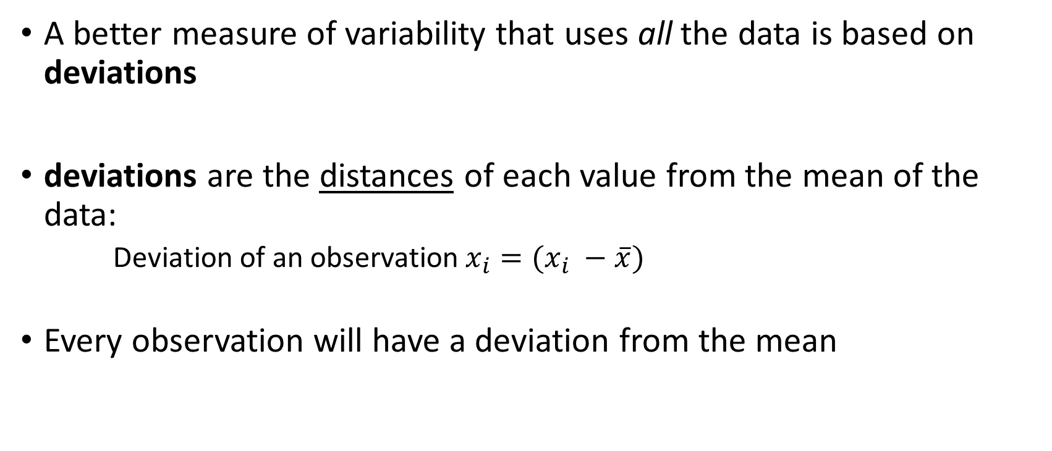
Measures of Spread: Deviation
A better measure of variability that uses all the data is based on deviations
deviations are the distances of each value from the mean of the data:
Deviation of an observation$x_{i}=(x_{i} −\overline{x})$
Every observation will have a deviation from the mean

Slide 18
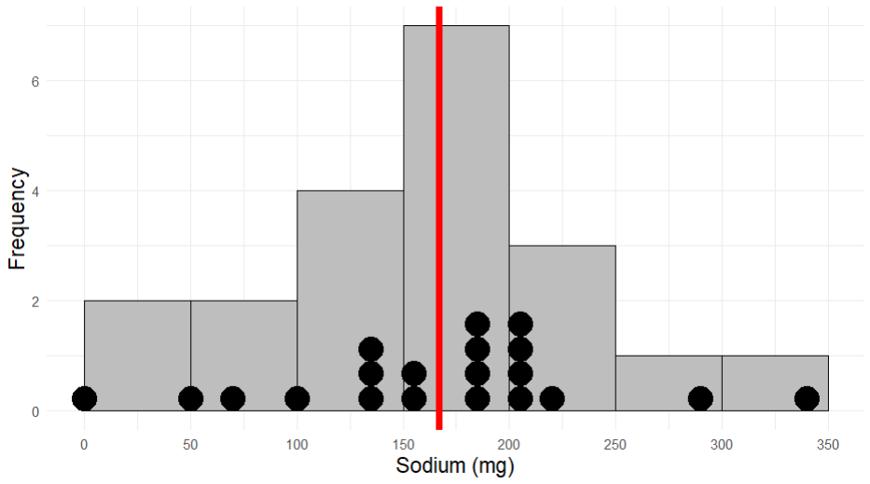


Frosted Mini Wheats = 0 (mg)
Mean = 167 (mg)
Rice Krispes = 340 (mg)
$$0 −167=−167$$
$$340 −167=173$$

Slide 19
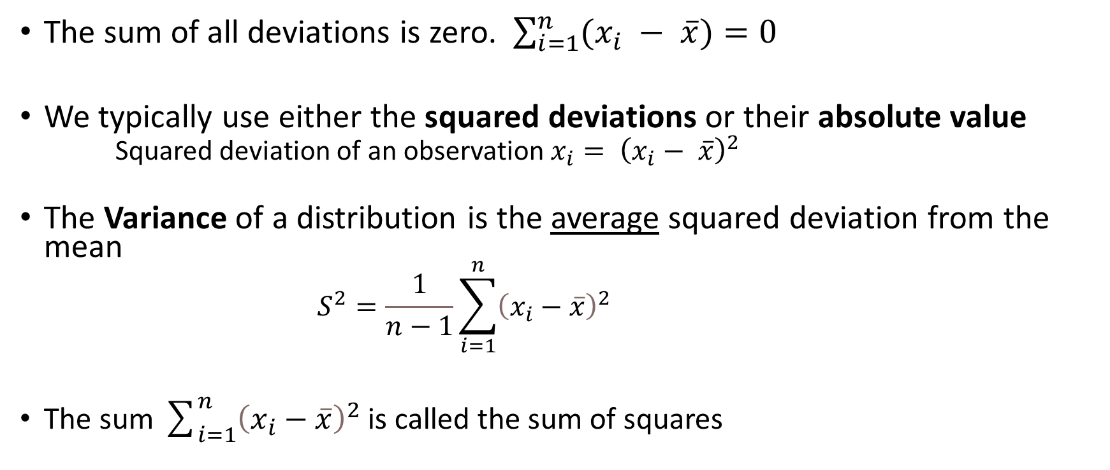
Measures of Spread: Variance
The sum of all deviations is zero. $\sum_{i=1}^{n}{(x_{i} − \overline{x})}=0$
We typically use either the squared deviations or their absolute value
Squared deviation of an observation $x_{i}= {\left(x_{i}− \overline{x}\right)}^{2}$
The Variance of a distribution is the average squared deviation from the mean
$$S^{2}=\frac{1}{n−1}\sum_{i=1}^{n}{{\left(x_{i}−\overline{x}\right)}^{2}}$$
The sum $\sum_{i=1}^{n}{{\left(x_{i}−\overline{x}\right)}^{2}}$ is called the sum of squares

Slide 20
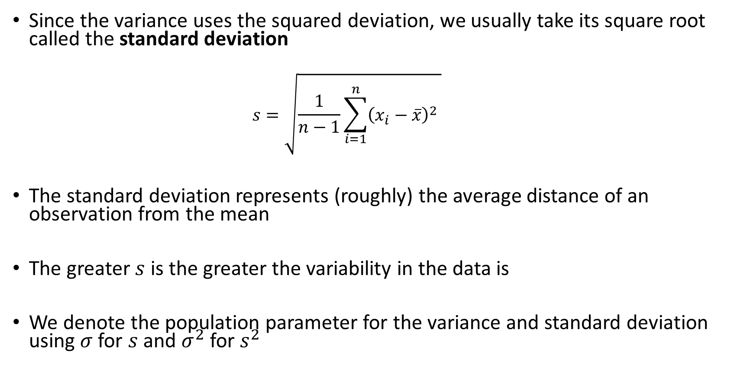
Measures of Spread: Standard Deviation
Since the variance uses the squared deviation, we usually take its square root called the standard deviation
$$s=\sqrt{\frac{1}{n−1}\sum_{i=1}^{n}{{\left(x_{i}−\overline{x}\right)}^{2}} }$$
The standard deviation represents (roughly) the average distance of an observation from the mean
The greater $s$ is the greater the variability in the data is
We denote the population parameter for the variance and standard deviation using $σ$ for $s$ and $σ^{2}$ for $s^{2}$

Slide 21
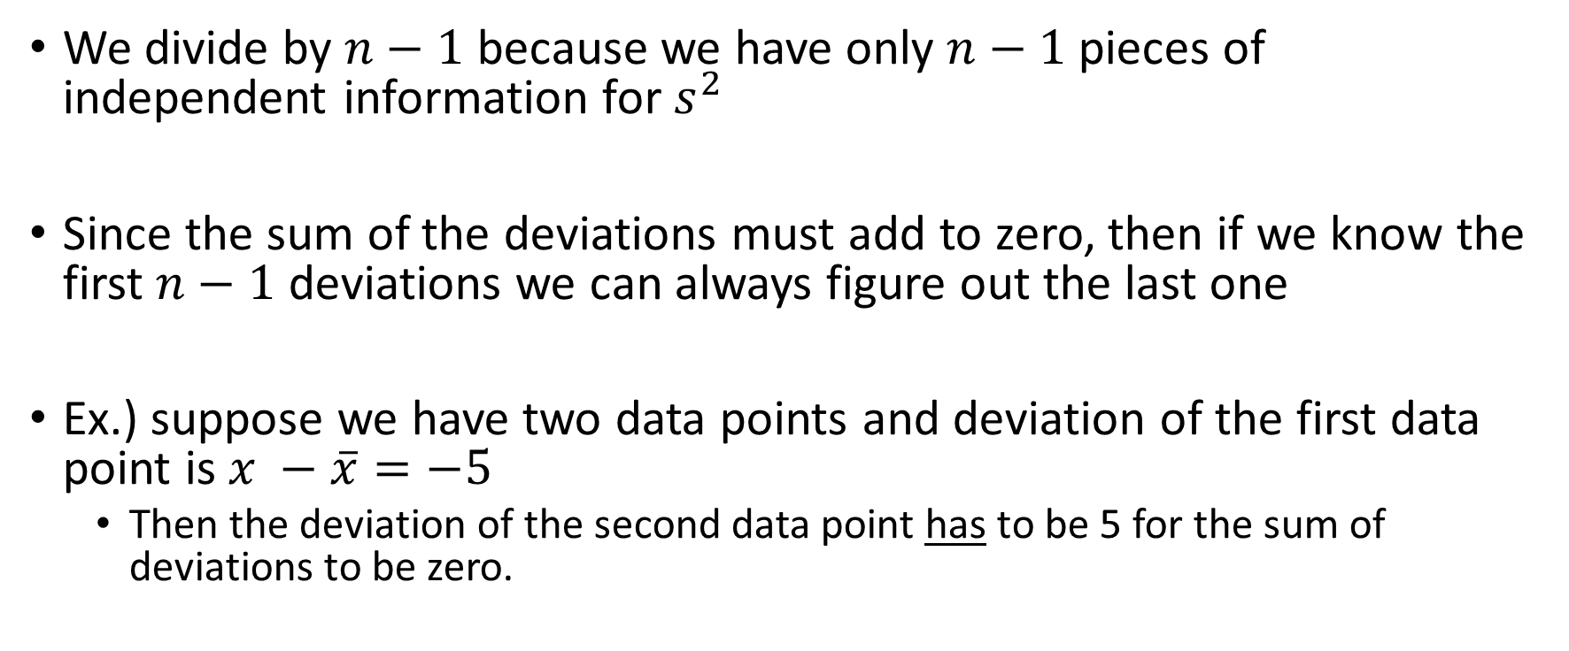

Why divide by $n−1$ ?
We divide by $n−1$ because we have only $n−1$pieces of independent information for $s^{2}$
Since the sum of the deviations must add to zero, then if we know the first $n−1$ deviations we can always figure out the last one
Ex.) suppose we have two data points and deviation of the first data point is $x −\overline{x}=−5$
Then the deviation of the second data point has to be 5 for the sum of deviations to be zero.

Slide 22
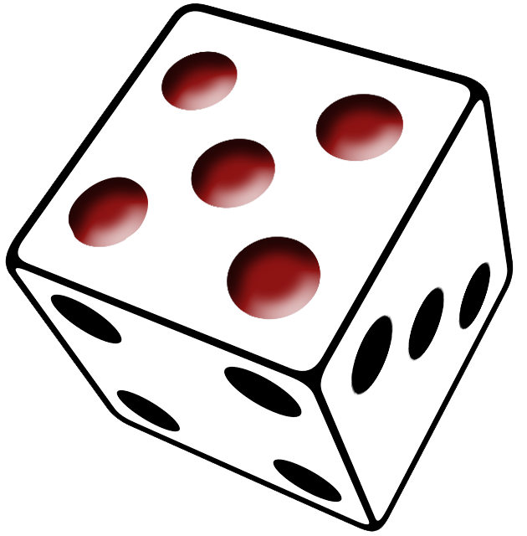

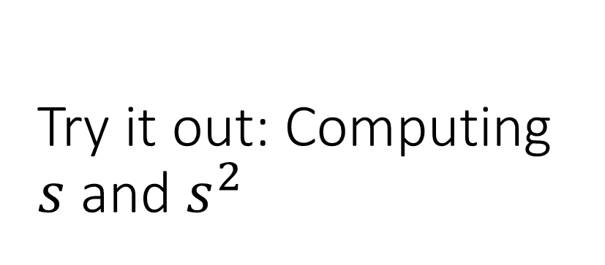
Try it out: Computing $s$ and $s^{2}$
Roll a six-sided die $n=10$ times and record the number rolled each time
Data = 1,2,3,3,4,4,4,5,6,6
Mean = 3.8

